Slide 1

What do we know about our most popular music content in 2000-2019?

Slide 2
Top songs summary
Total number of songs: 1942
Number of unique song titles: 1874
Total number of artists/bands: 835
Average song duration in seconds: 229

Slide 3
How many songs do the featured artists have?

Slide 4
Are there any artist or bands from top 15, who create mostly negative-tinged songs?

Slide 5
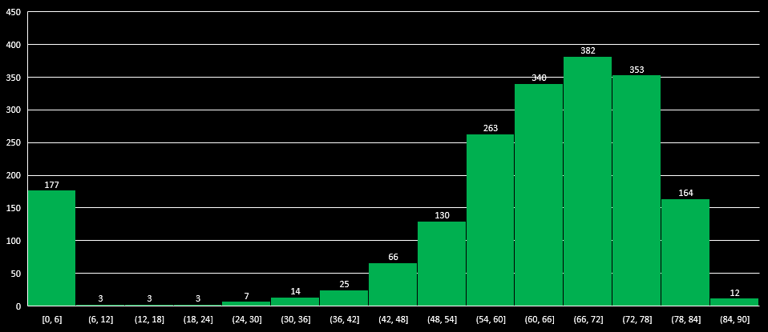
Are the songs on our list really popular?

Slide 6
How many songs published each year?

Slide 7
Do artists create longer songs today?

Slide 8
Do recently released songs have a faster tempo (BPM) in general than years ago?

Slide 9
What kind of music is most popular among Spotify’s listeners?

Slide 10
How many songs have explicit content? Is number of songs with explicit content increasing?
28% of all songs in our list have explicit content

Slide 11
Thank you for your attention!

